Slide 1
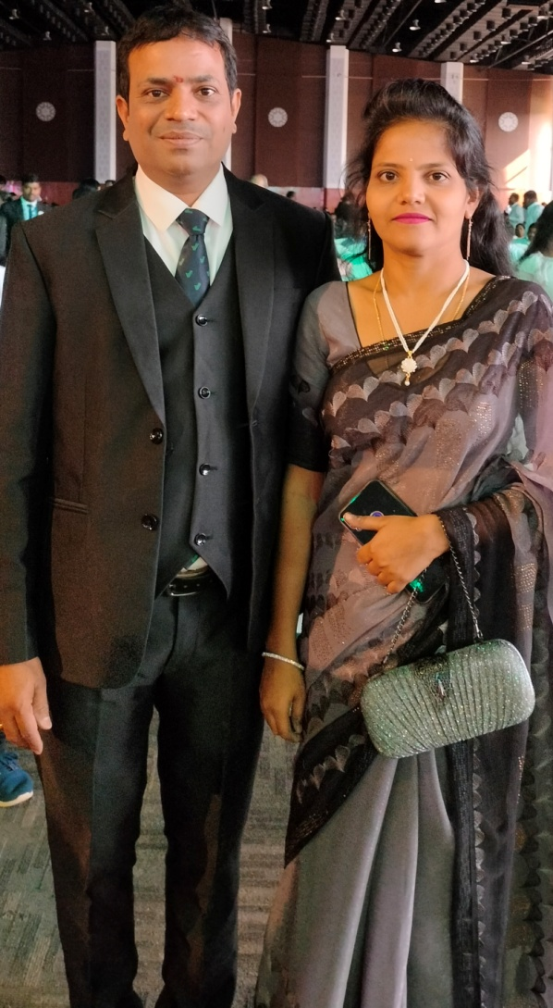
IMPORTANT OF PAC
Prasadrao & Pooja Deshpande

Slide 2
Dream
Minimum Crown With One Lakh

Slide 3
10 Core Steps
System
School - Dairy
Office - Boss - Schedule - Fear
But in Business………. ?

Slide 4
CORE
Do 160 PPV (But Now 500 PV)
STP (With Demo)
Loyal Customers
Vestige & WT App (Tools)
……………. What About PAC ?

Slide 5
Why PAC
Personal Activity Circle
Hospital - Patient - Reports
Stomach Pain
Endoscopy - Less Medicine - Small Bill - Fast Result
Coma Patient……?

Slide 6
What About Your Business Report
PAC – Daily Basic Record
Daily Joining / PV
Monthly Personal & Group PV
PAC Means Create HABIT
Discipline

Slide 7
Show The Plan
Zoom In: Zoom Out: Review: Date:
Today Call History
S.no | Name | Ph No | Calling Time | Answer
1 | Ramesh | 9989 ….. | 8 AM | Tomorrow 11 Am Plan at Home
2 | Suresh | 9963…. | 9.15 PM | Not Interested
3 | Naresh | 9032…. | 4 PM | Follow Up
4 | Somesh | 7703…… | 4.10PM | Meeting Invitation
8
9
10

Slide 8
Show The Plan
Show The Plan Date:
S.no | Name | Ph no / Place | Time | Photo/ Selfy | Result | Follow Up
1 | Ramesh | 9989 ….. Medak | 8 AM | Taken | Business | Day after Tomorrow
2 | Suresh | 9963…. Sangareddy | 9.15 PM | Customer | Not Interested
3 | Naresh | 9032…. | 4 PM |  | Agri
4 | Somesh | 7703…… | 4.10PM |  | Health
 |  |  |  |  | Customer
 |  |  |  |  | Next week
8
9
10

Slide 9
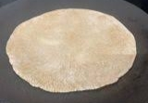
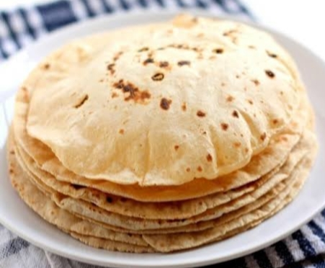
Half Cooked Roti
Ready To Eat
Follow Up and Depth Drive

Slide 10

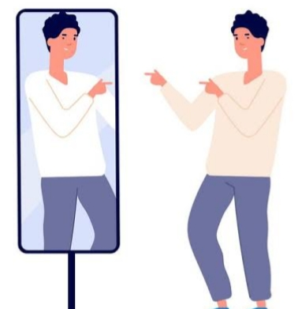

Slide 11
NO PAC – NO COUNSILING

Slide 12
Thank You

